Slide 1
Project Regression
Jan Markiewicz

Slide 2
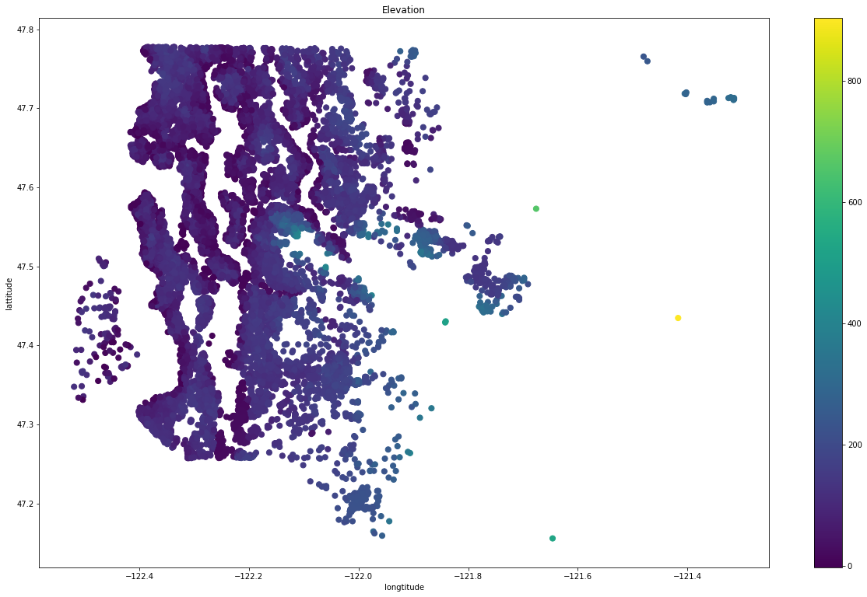
Data

Slide 3
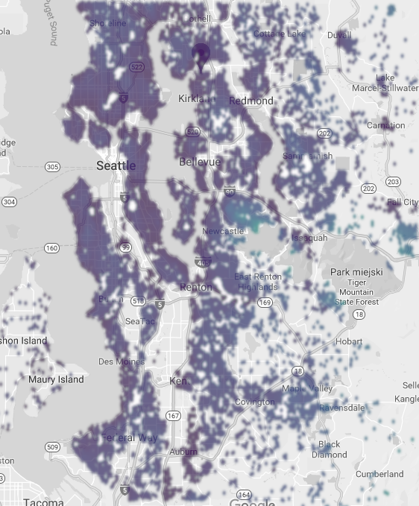
Data on map

Slide 4
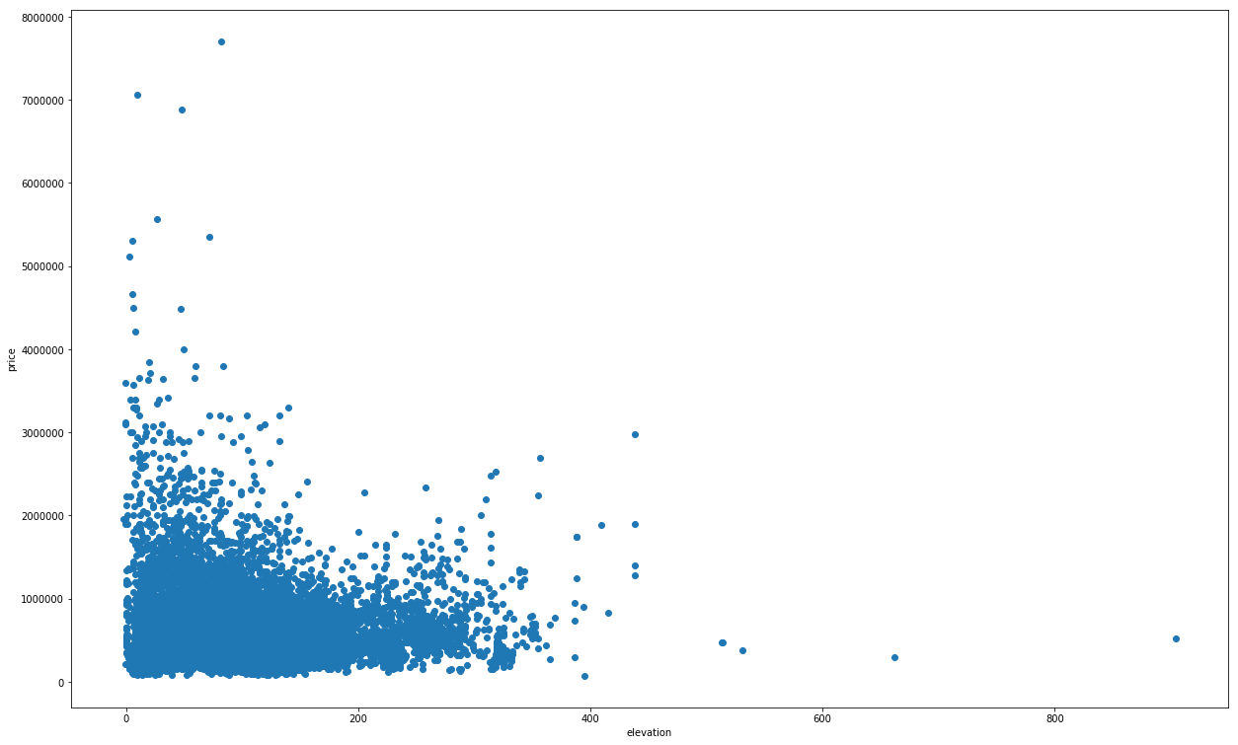
Elevation to price relation

Slide 5
Limit the data

Slide 6
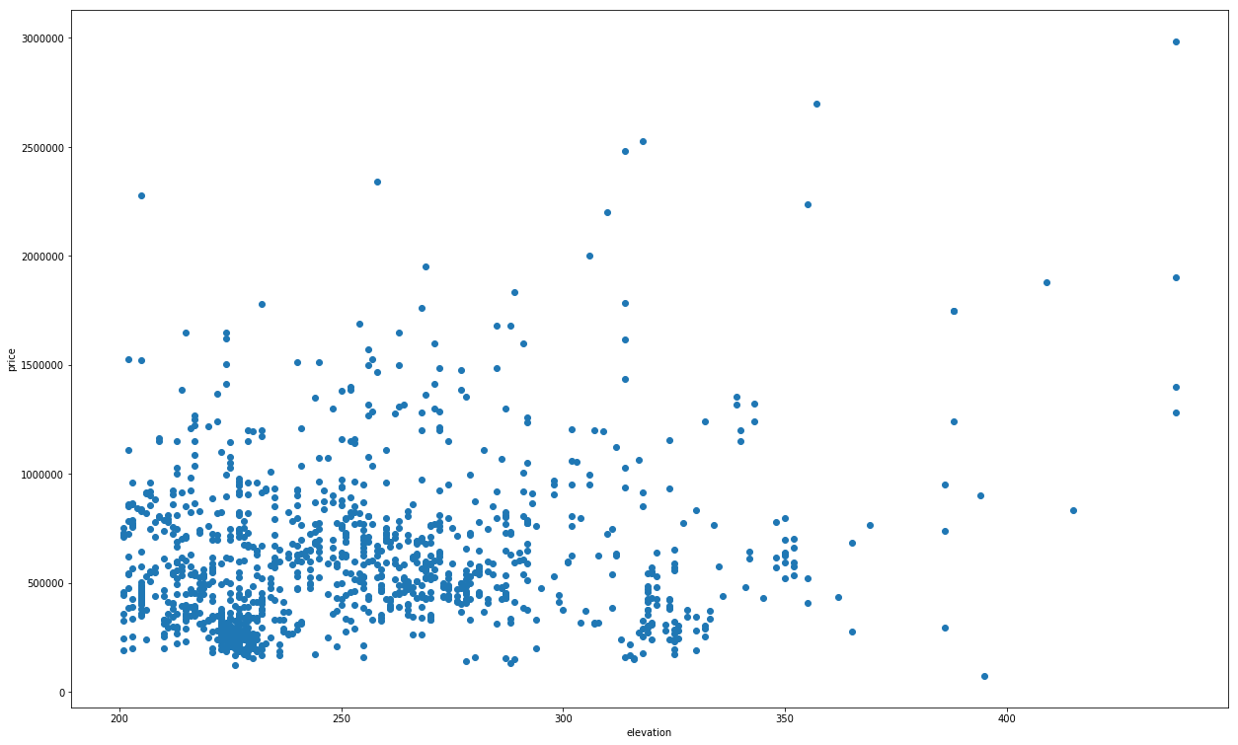
Elevation to price relation

Slide 7
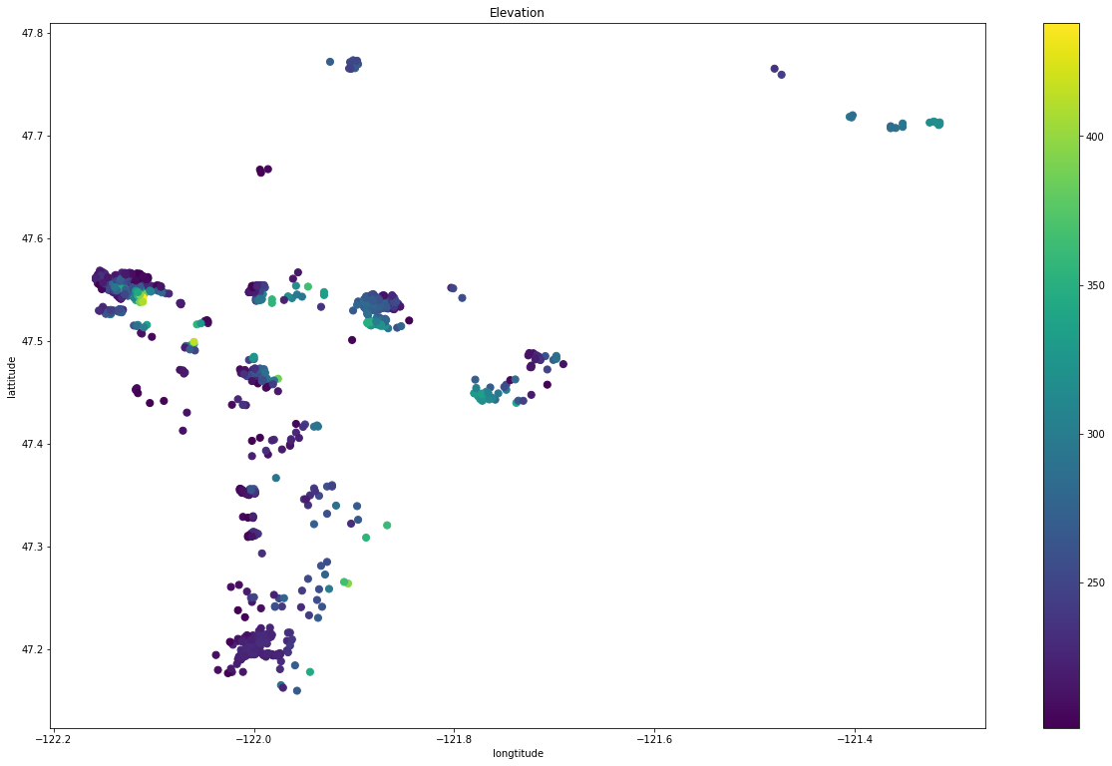
Filtered data

Slide 8
Parametric regression

Slide 9
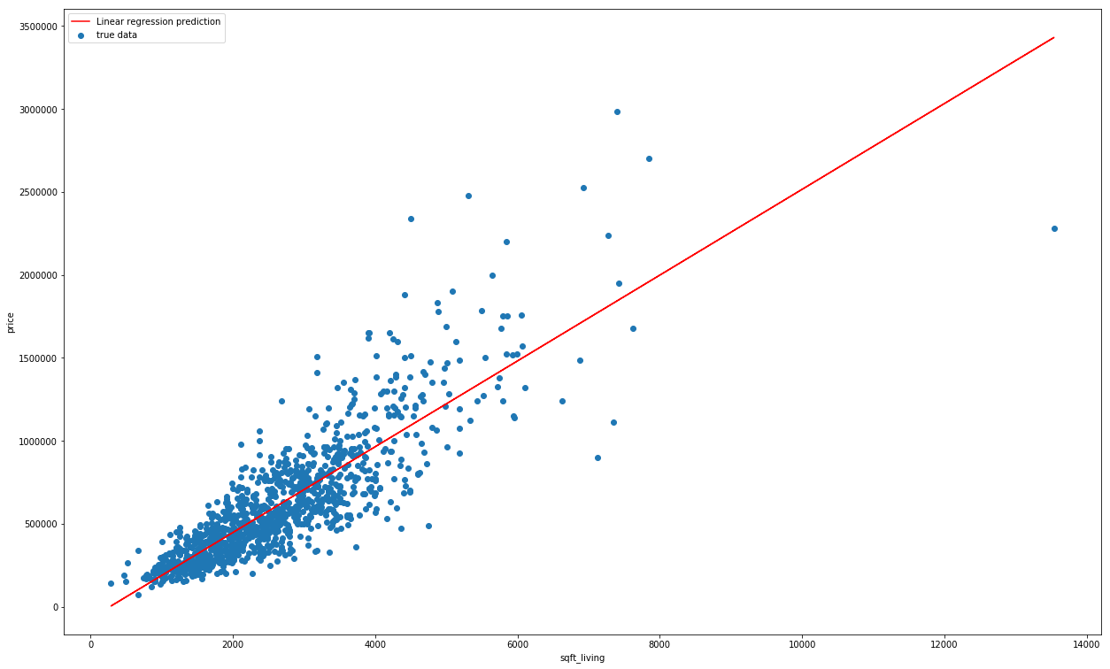
Linear regression model based on one feature

Slide 10
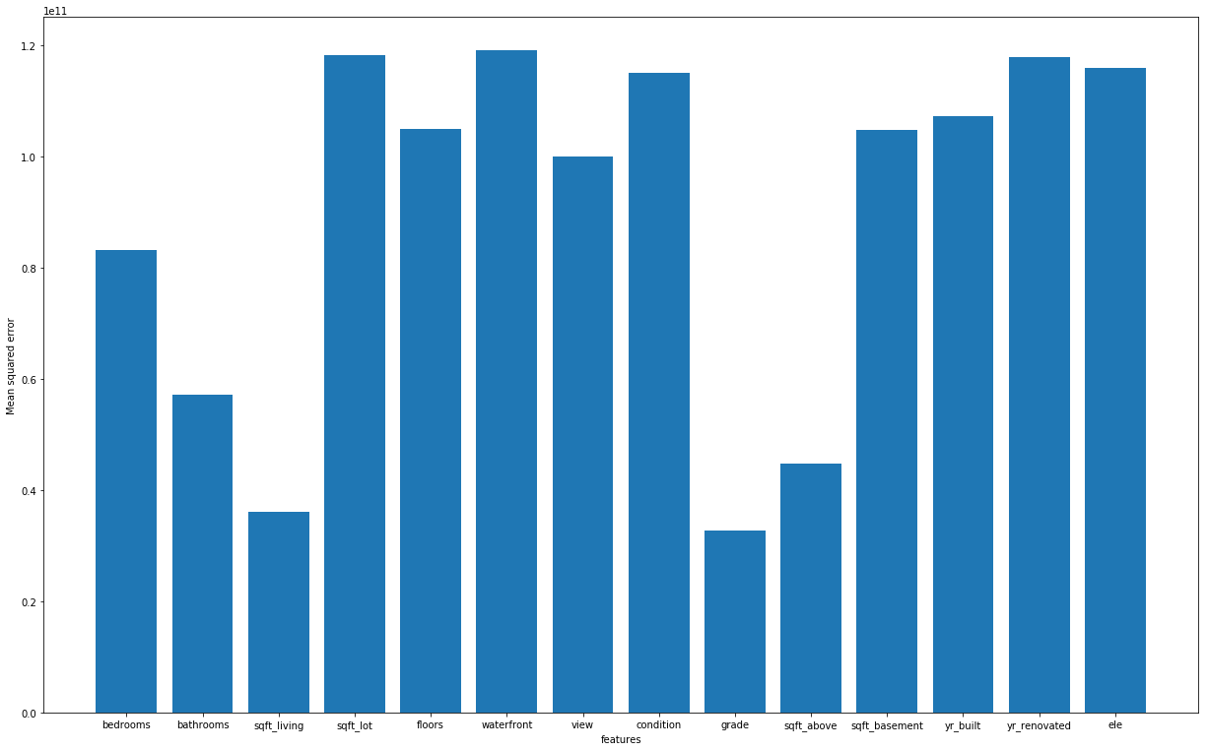
Finding features with greedy algorithm: 1st iteration

Slide 11
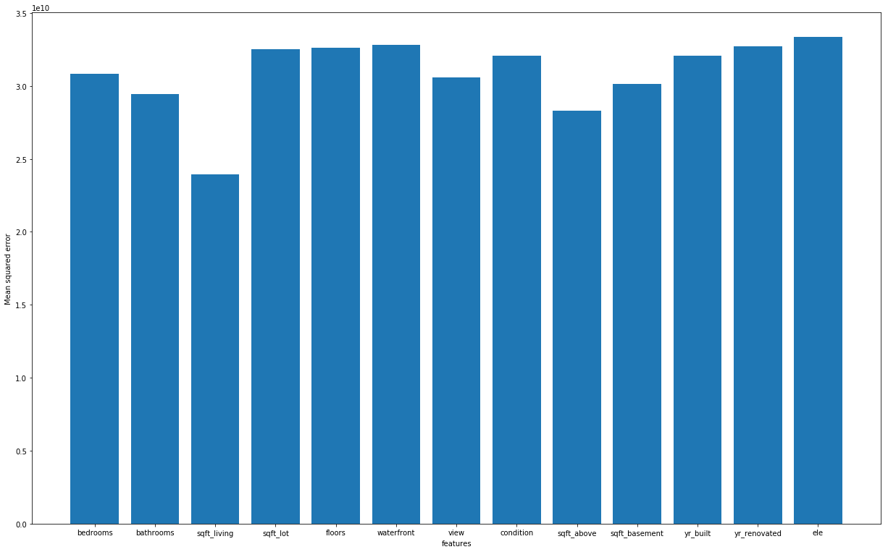
Finding features with greedy algorithm: 2nd iteration

Slide 12
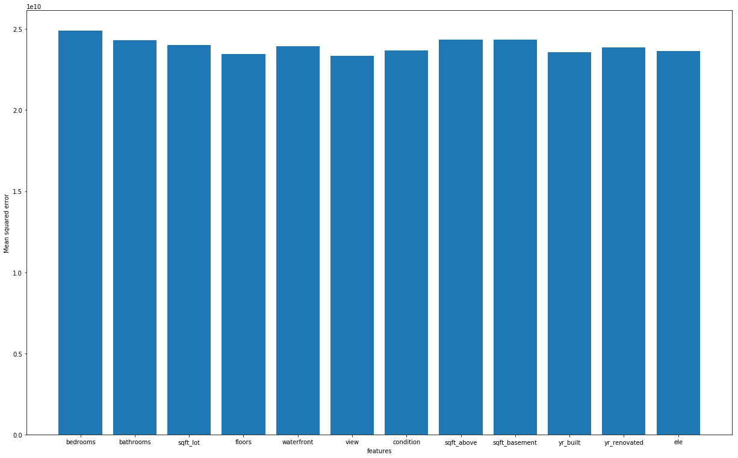
Finding features with greedy algorithm: 3rd iteration

Slide 13
Non-parametric regression

Slide 14
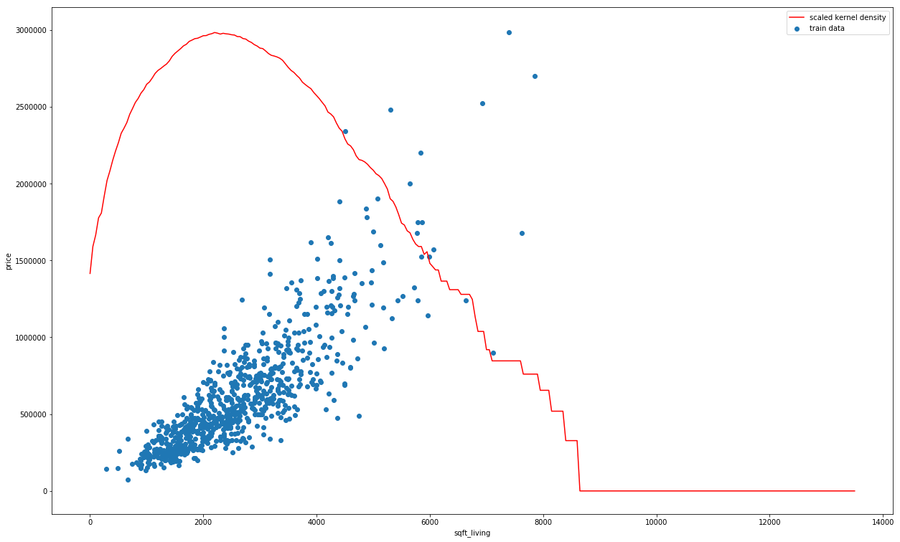
KNN: boxcar kernel

Slide 15
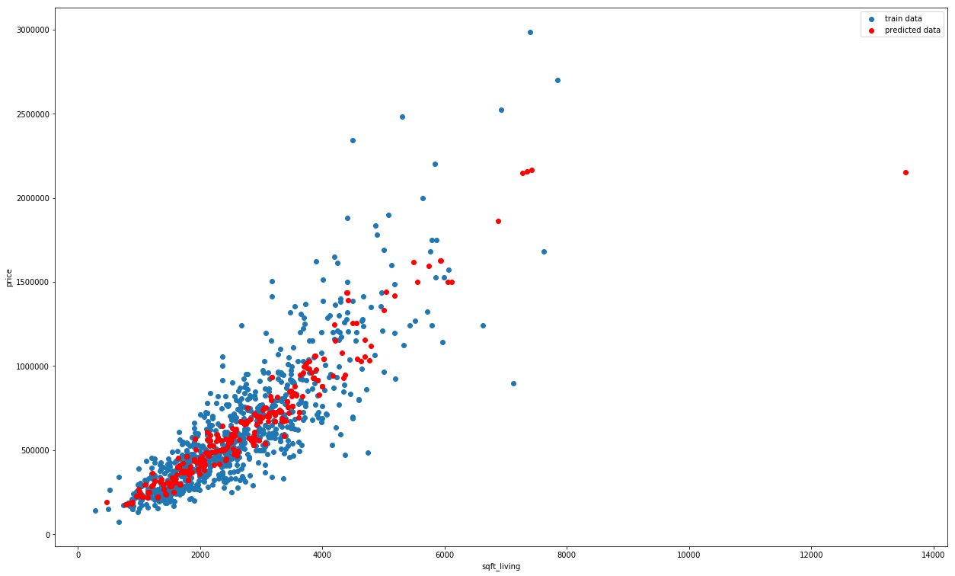
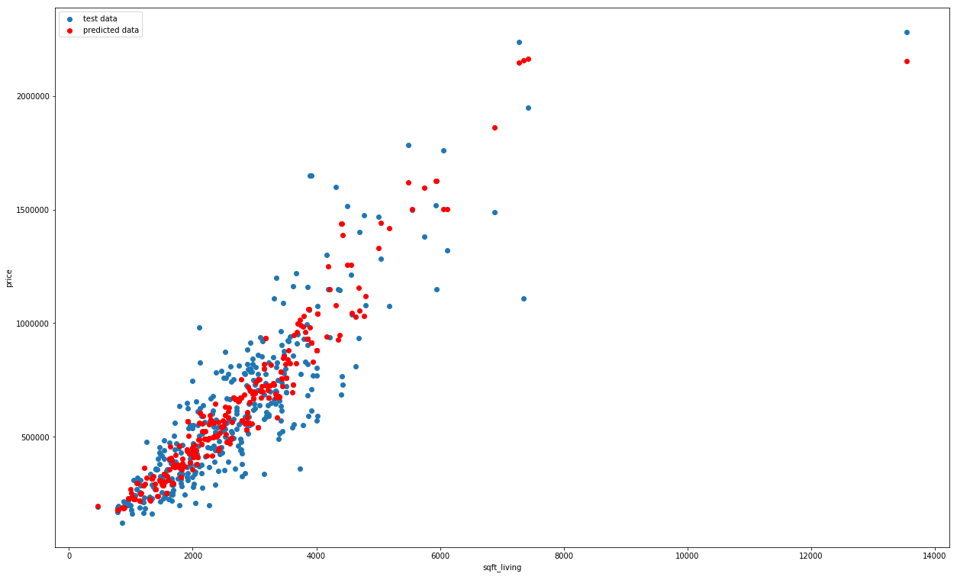
KNN: boxcar kernel
train data
test data

Slide 16
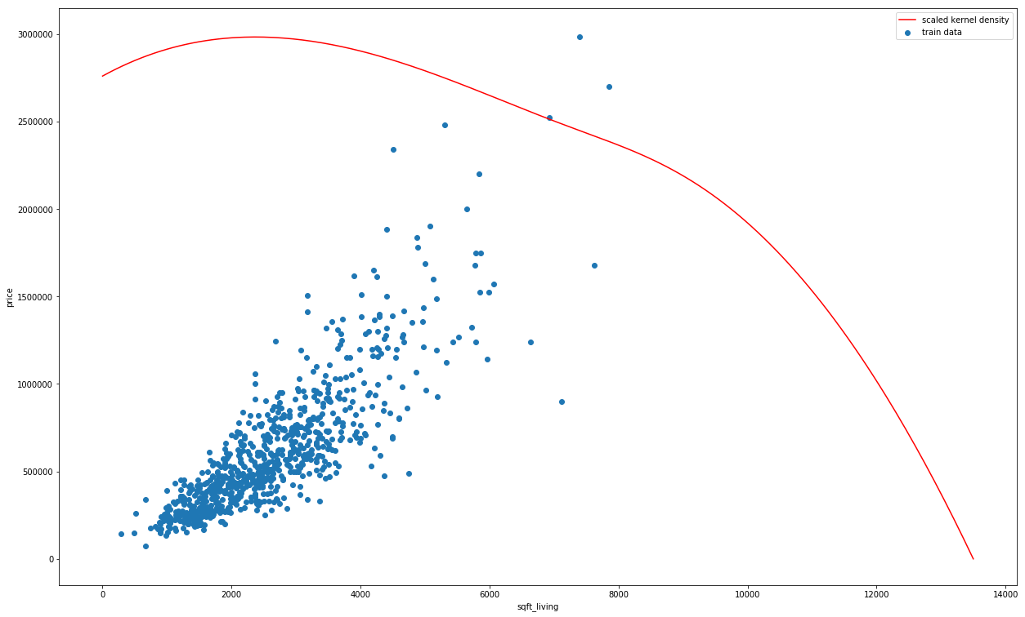
KNN: gaussian kernel

Slide 17

KNN: gaussian kernel
train data
test data

Slide 18
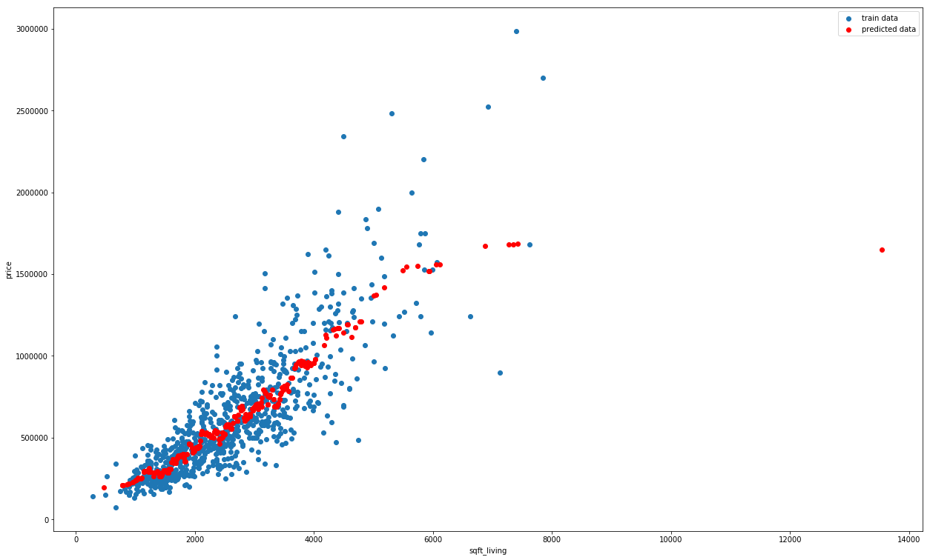
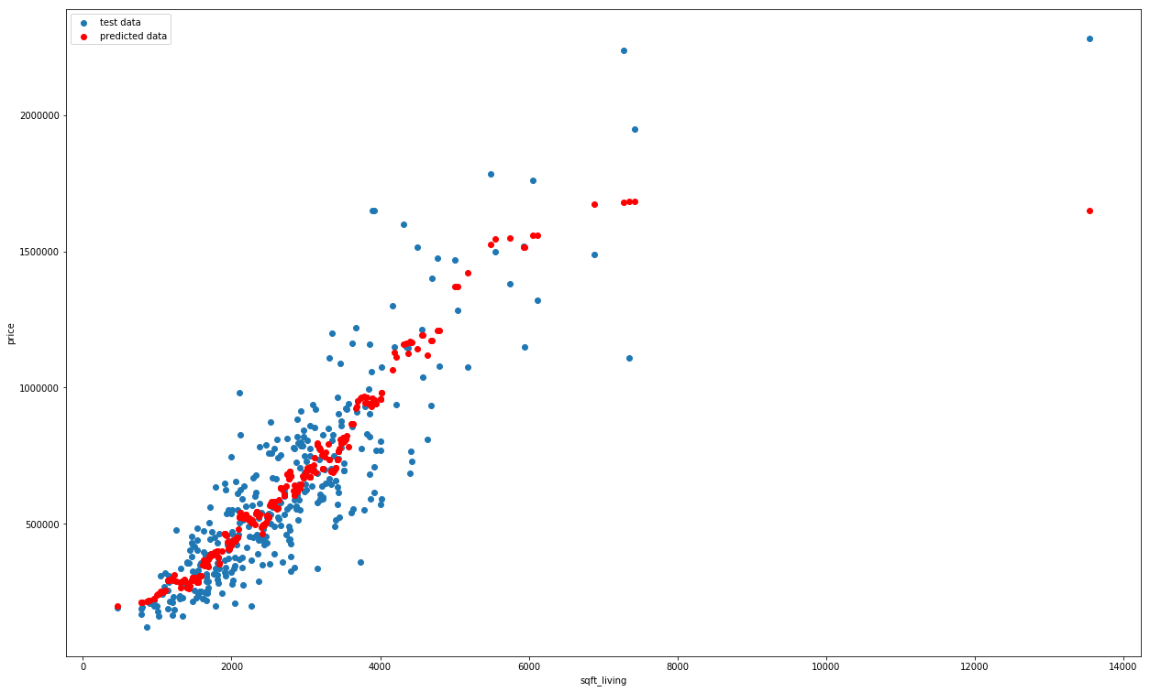
Increasing neighbours count from 5 to 20
train data
test data

Slide 19
Models summary, accuracy
Linear regression model with 1 feature: 33560755766.796795
Linear regression model with 3 feature: 23336964981.238964
KNN with boxcar kernel for 5 neighbours: 37346229495.2342
KNN with gaussian kernel for 5 neighbours: 37343083875.81784
KNN with for 25 neighbours: 31548111783.813534

Slide 20
5 highest houses above the sea level
sqft elevation price np_prediction p_prediction 0 4660 438 1280000.0 1.136111e+06 1.343920e+06 1 4700 438 1400000.0 1.171538e+06 1.349758e+06 2 7400 438 2983000.0 1.697588e+06 1.982083e+06 3 5080 438 1900000.0 1.367091e+06 1.405222e+06 4 4460 415 833450.0 1.139502e+06 1.063287e+06 np_prediction_delta p_prediction_delta abs_delta_sum 0 -1.438887e+05 6.391951e+04 2.078082e+05 1 -2.284622e+05 -5.024211e+04 2.787043e+05 2 -1.285412e+06 -1.000917e+06 2.286329e+06 3 -5.329092e+05 -4.947775e+05 1.027687e+06 4 3.060523e+05 2.298366e+05 5.358889e+05

Slide 21
5 highest houses above the sea level
sqft elevation price np_prediction p_prediction 0 4660 438 1280000.0 1.136111e+06 1.343920e+06 1 4700 438 1400000.0 1.171538e+06 1.349758e+06 2 7400 438 2983000.0 1.697588e+06 1.982083e+06 3 5080 438 1900000.0 1.367091e+06 1.405222e+06 4 4460 415 833450.0 1.139502e+06 1.063287e+06 np_prediction_delta p_prediction_delta abs_delta_sum 0 -1.438887e+05 6.391951e+04 2.078082e+05 1 -2.284622e+05 -5.024211e+04 2.787043e+05 2 -1.285412e+06 -1.000917e+06 2.286329e+06 3 -5.329092e+05 -4.947775e+05 1.027687e+06 4 3.060523e+05 2.298366e+05 5.358889e+05

